Slide 1
Module1: BODYFAT
By Tianqi Li, Tiannan Huang and Siyu Wang
Tues Group3

Slide 2
Outline of the Analysis
Data Cleaning
Model Selection
Model Diagnostic

Slide 3
Data Cleaning
Boxplot
BODYFAT Calculation
BMI Calculation

Slide 4
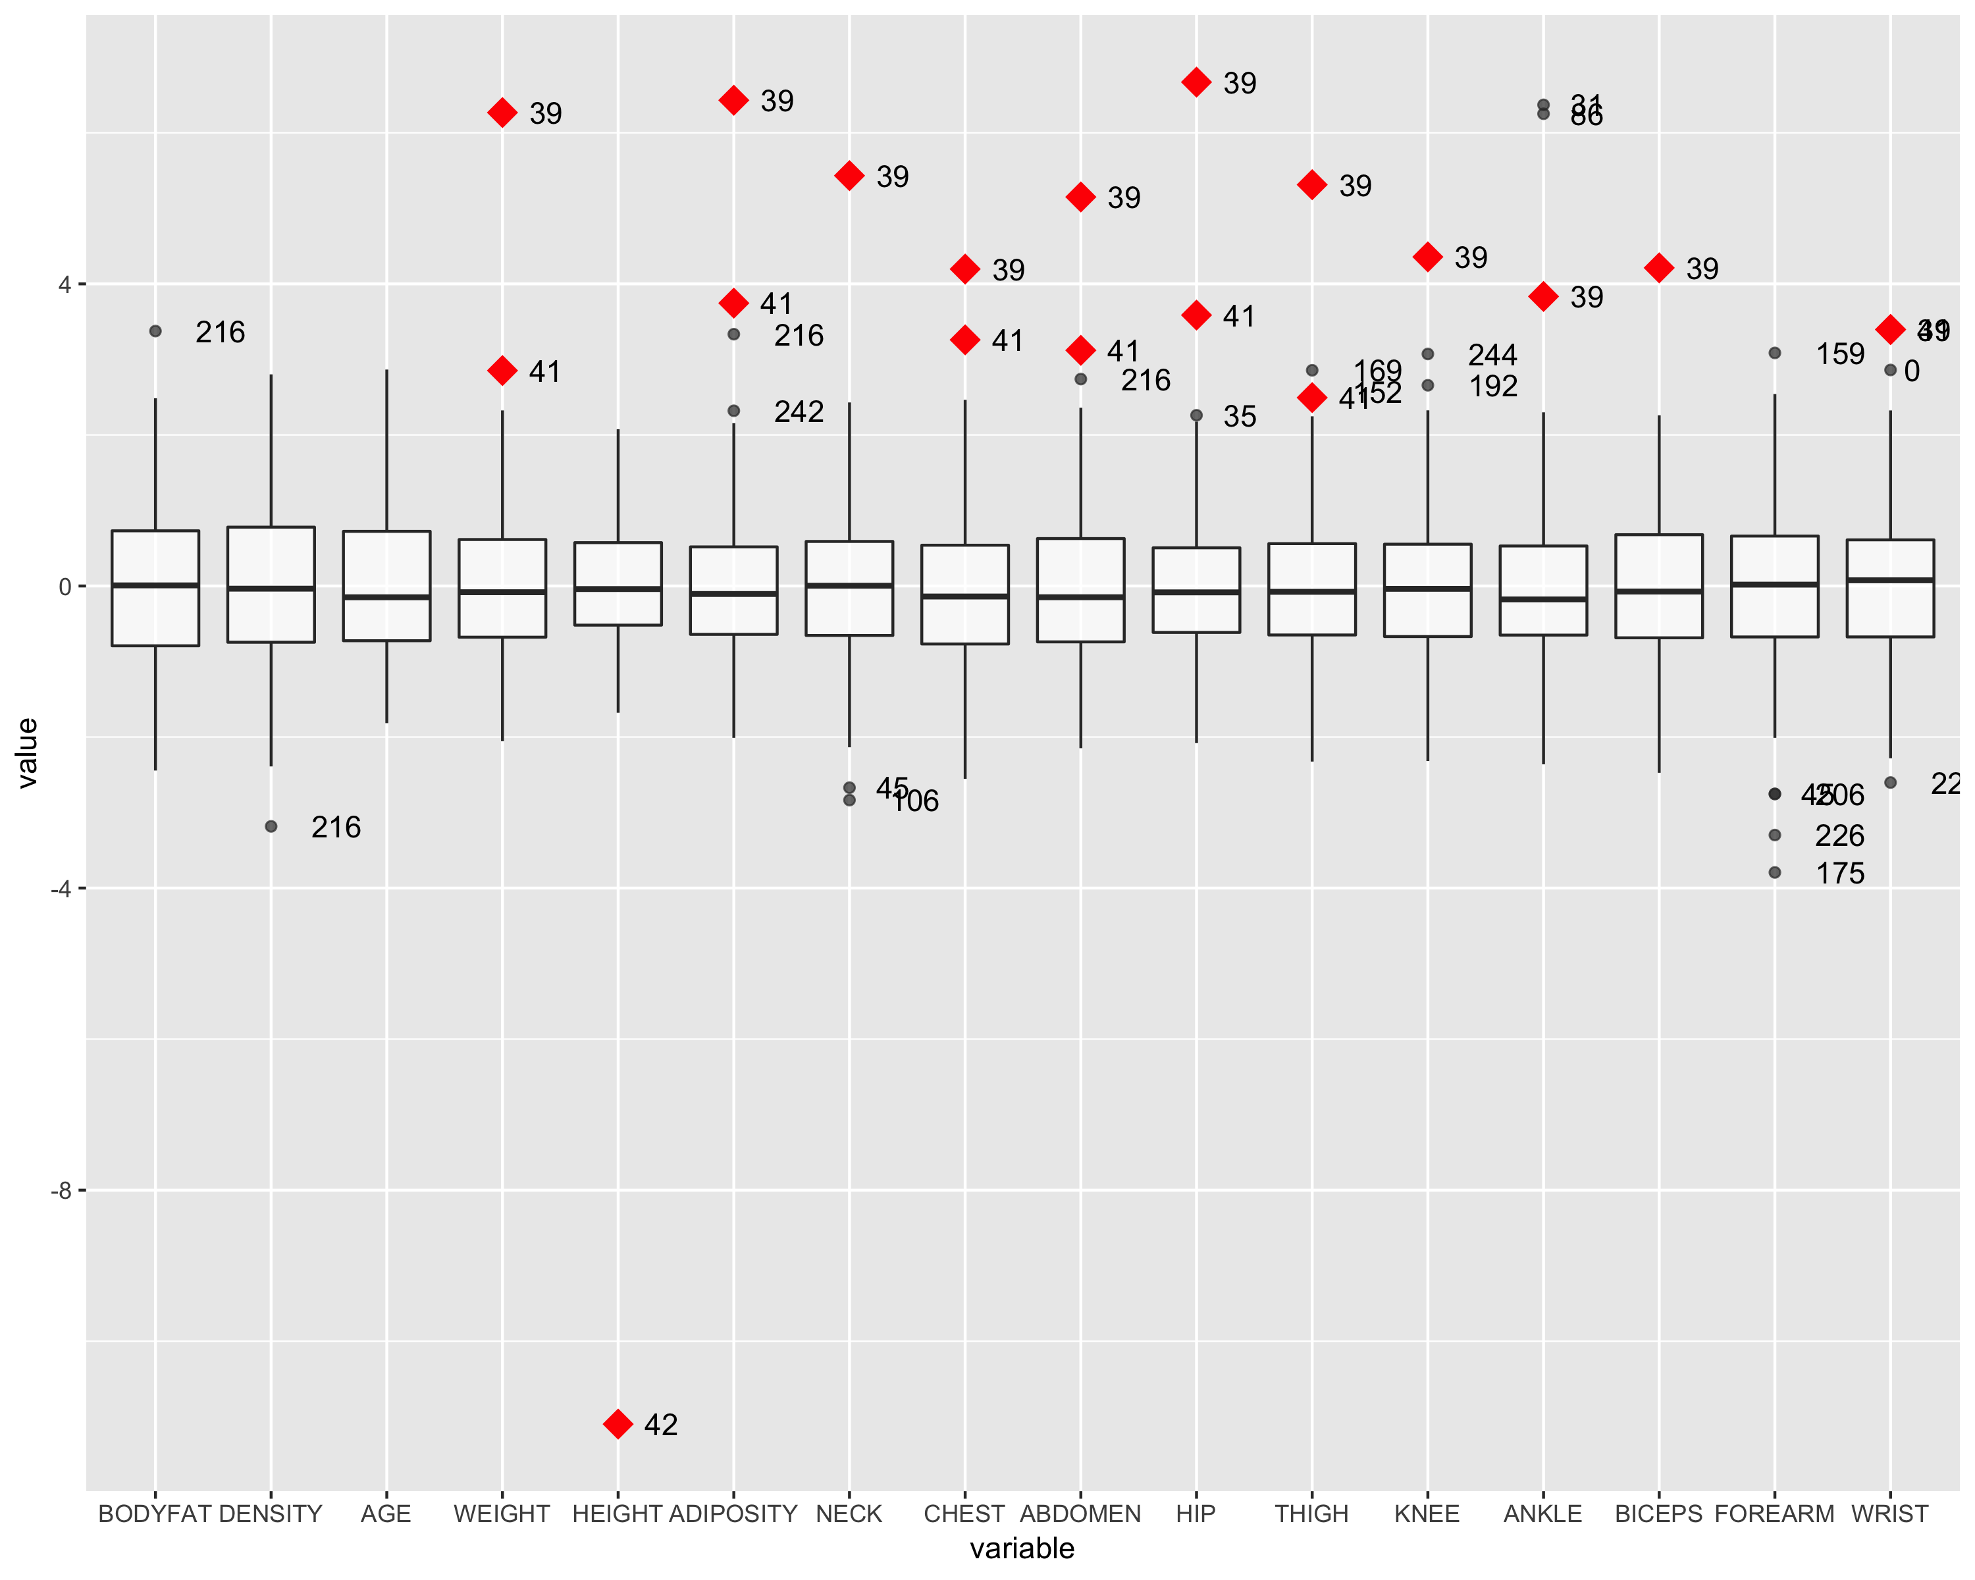
Boxplot 1

Slide 5
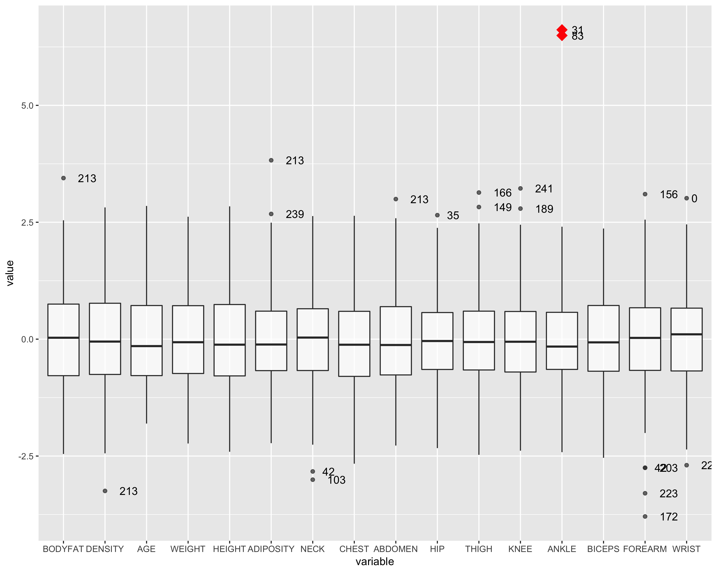
Boxplot 2
After removing point 39, 41 and 42

Slide 6
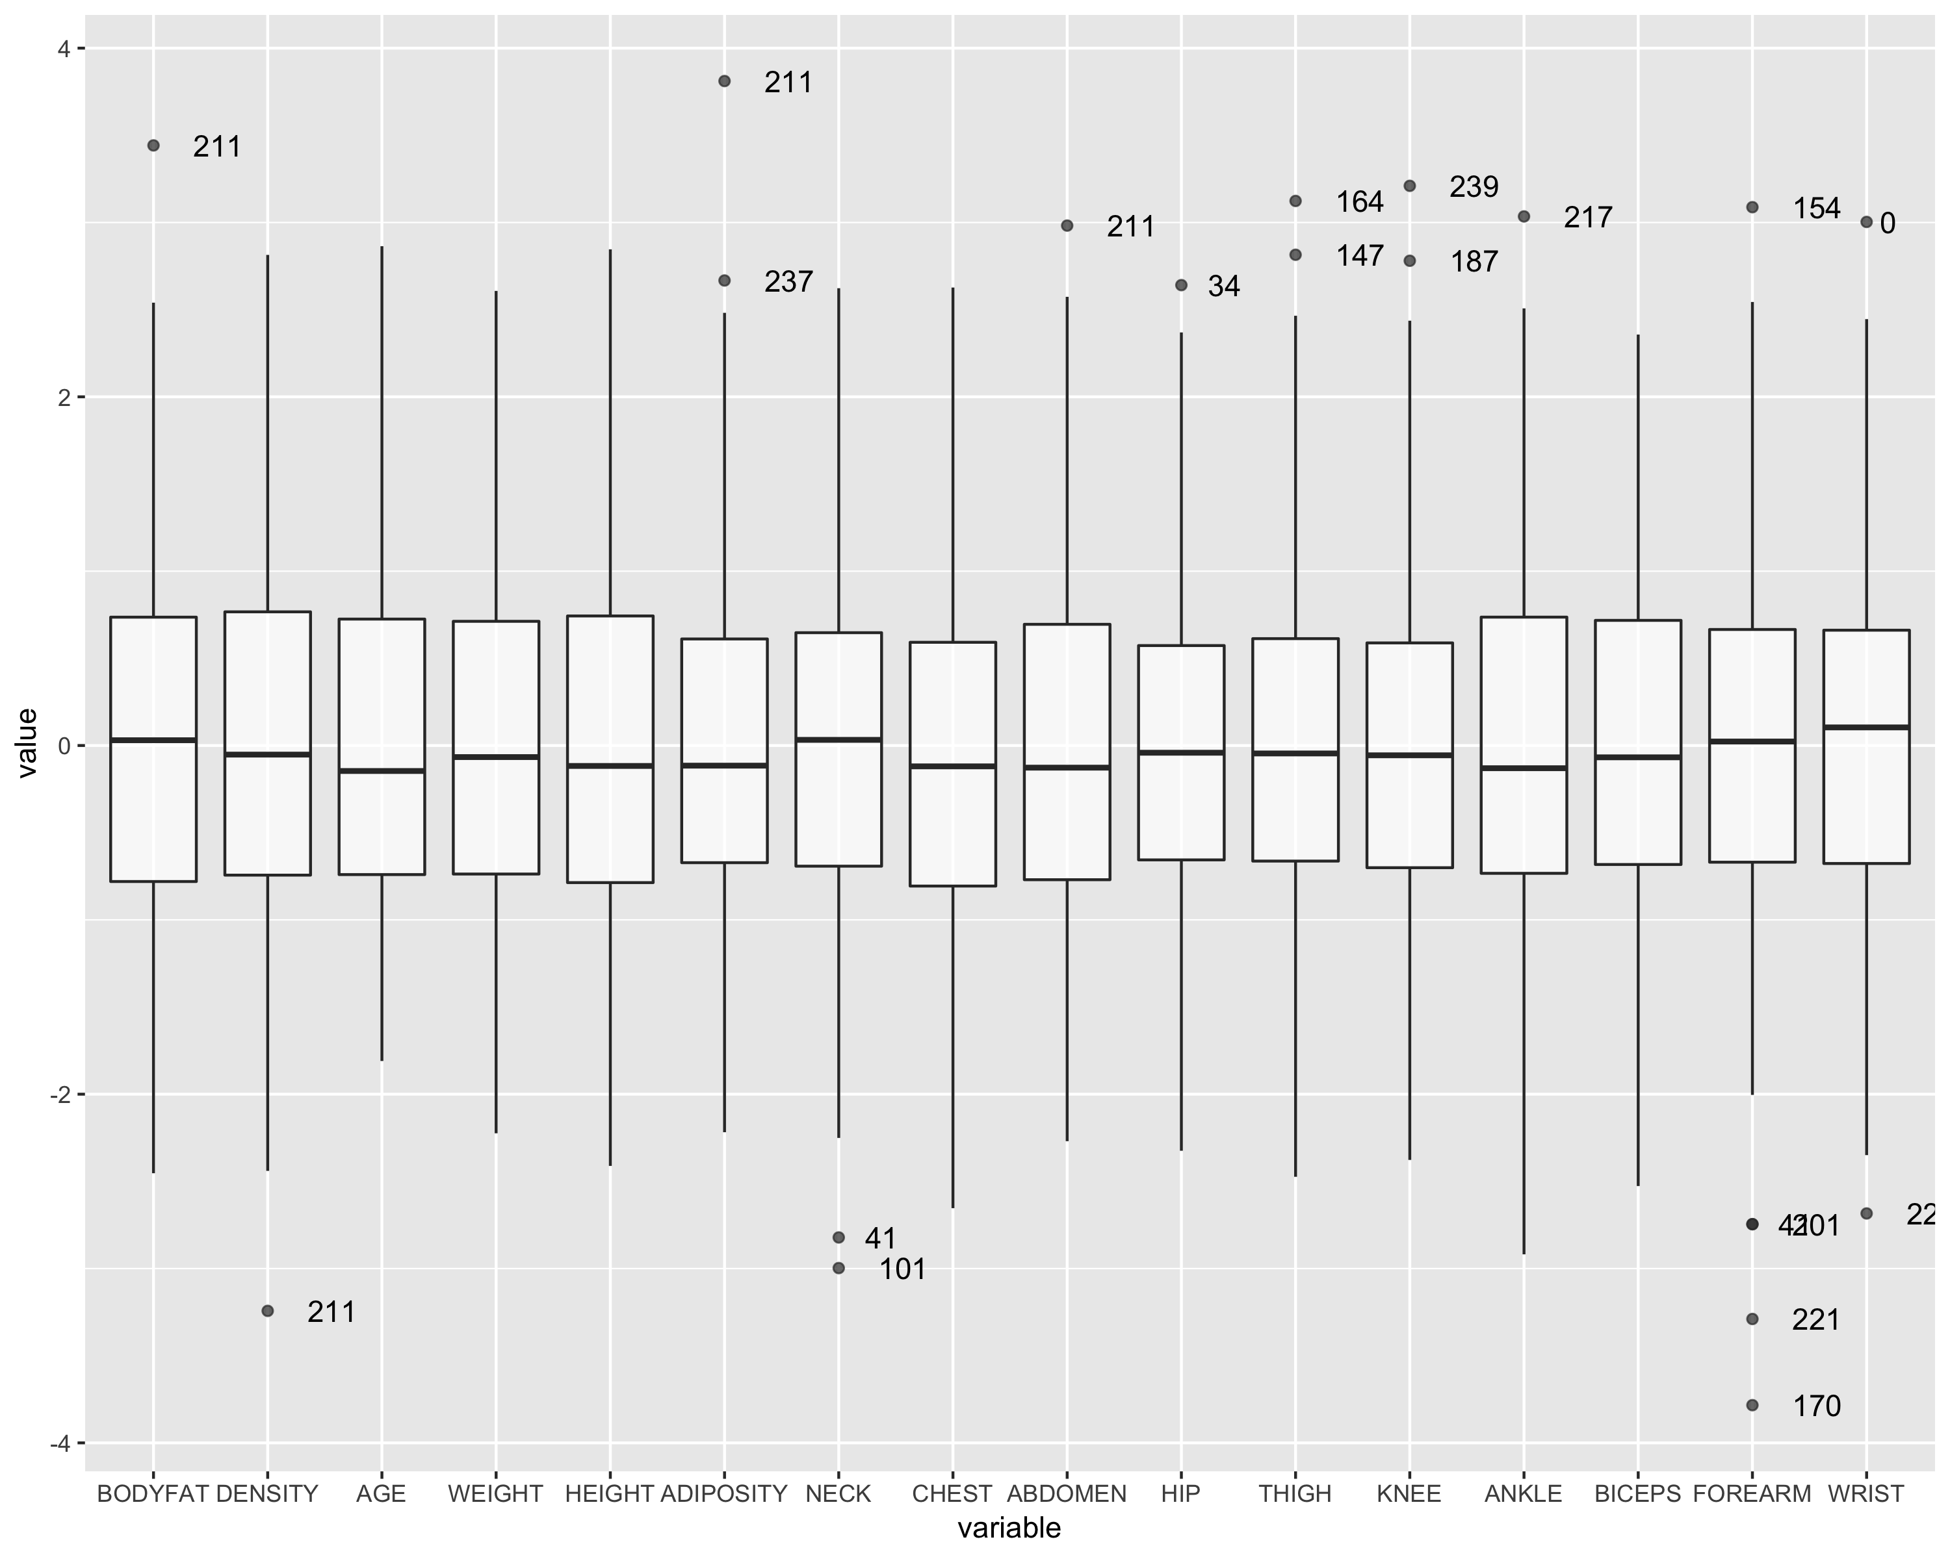
Boxplot 3
After removing point 31 and 83

Slide 7
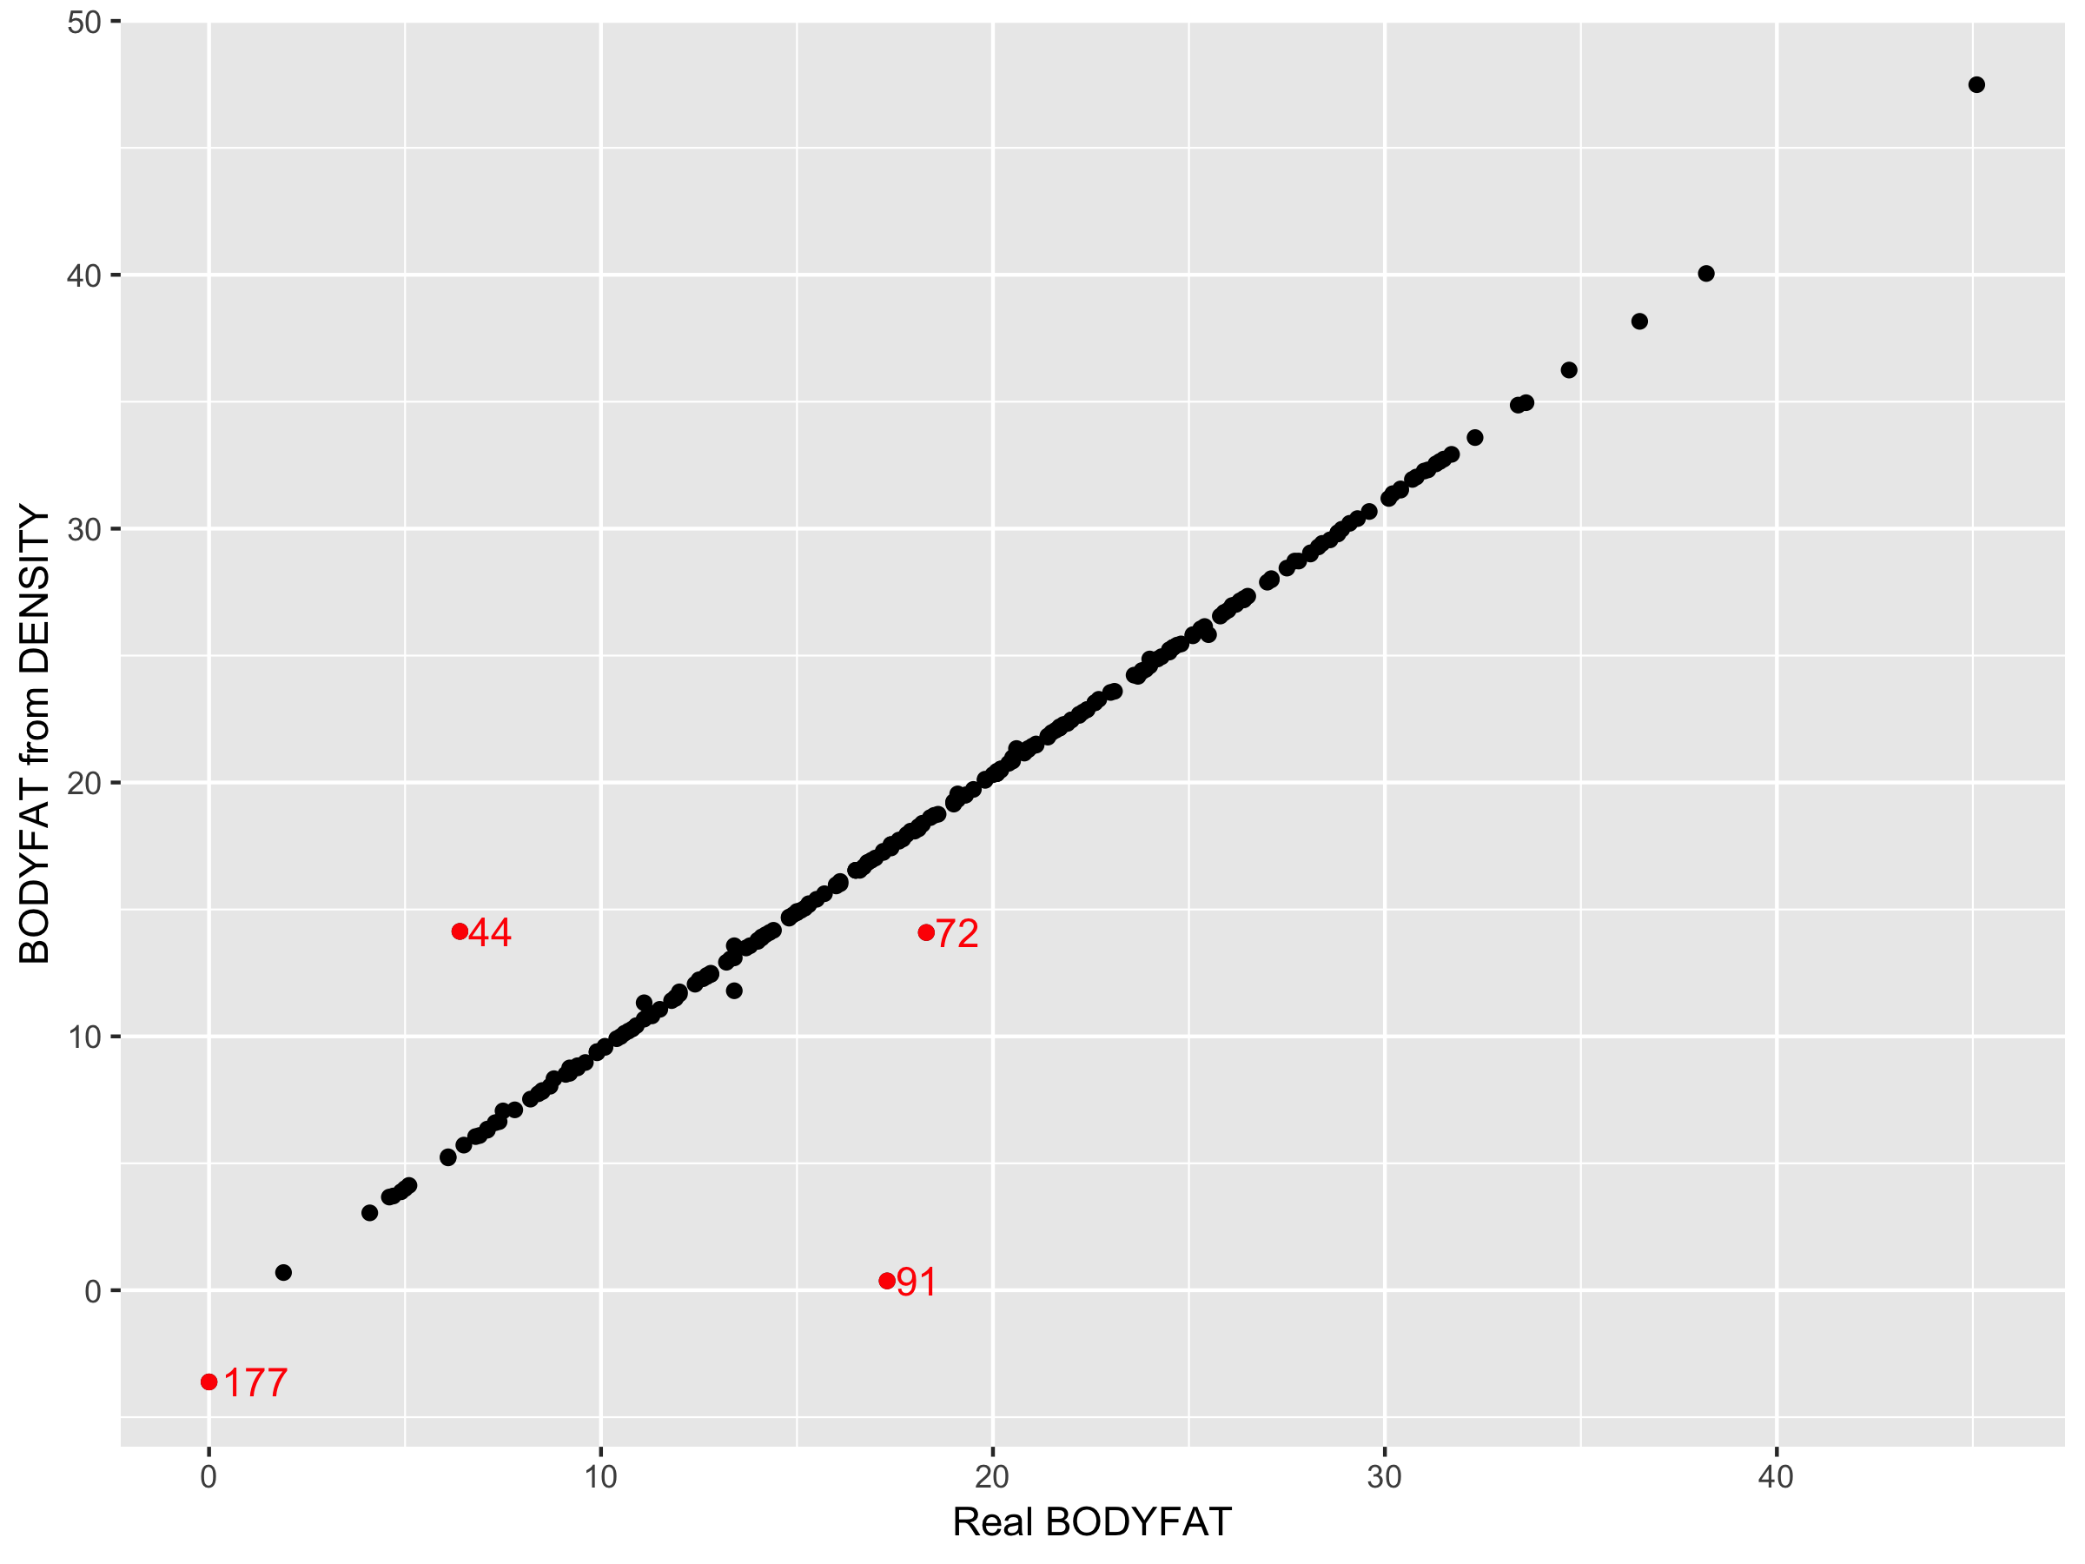
BODYFAT Calculation
BODYFAT = 495 / DENSITY - 450

Slide 8
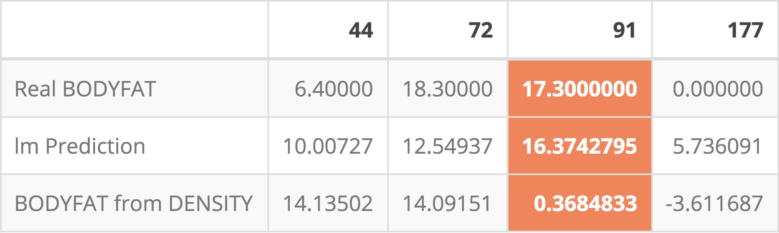
Linear Regression Prediction

Slide 9
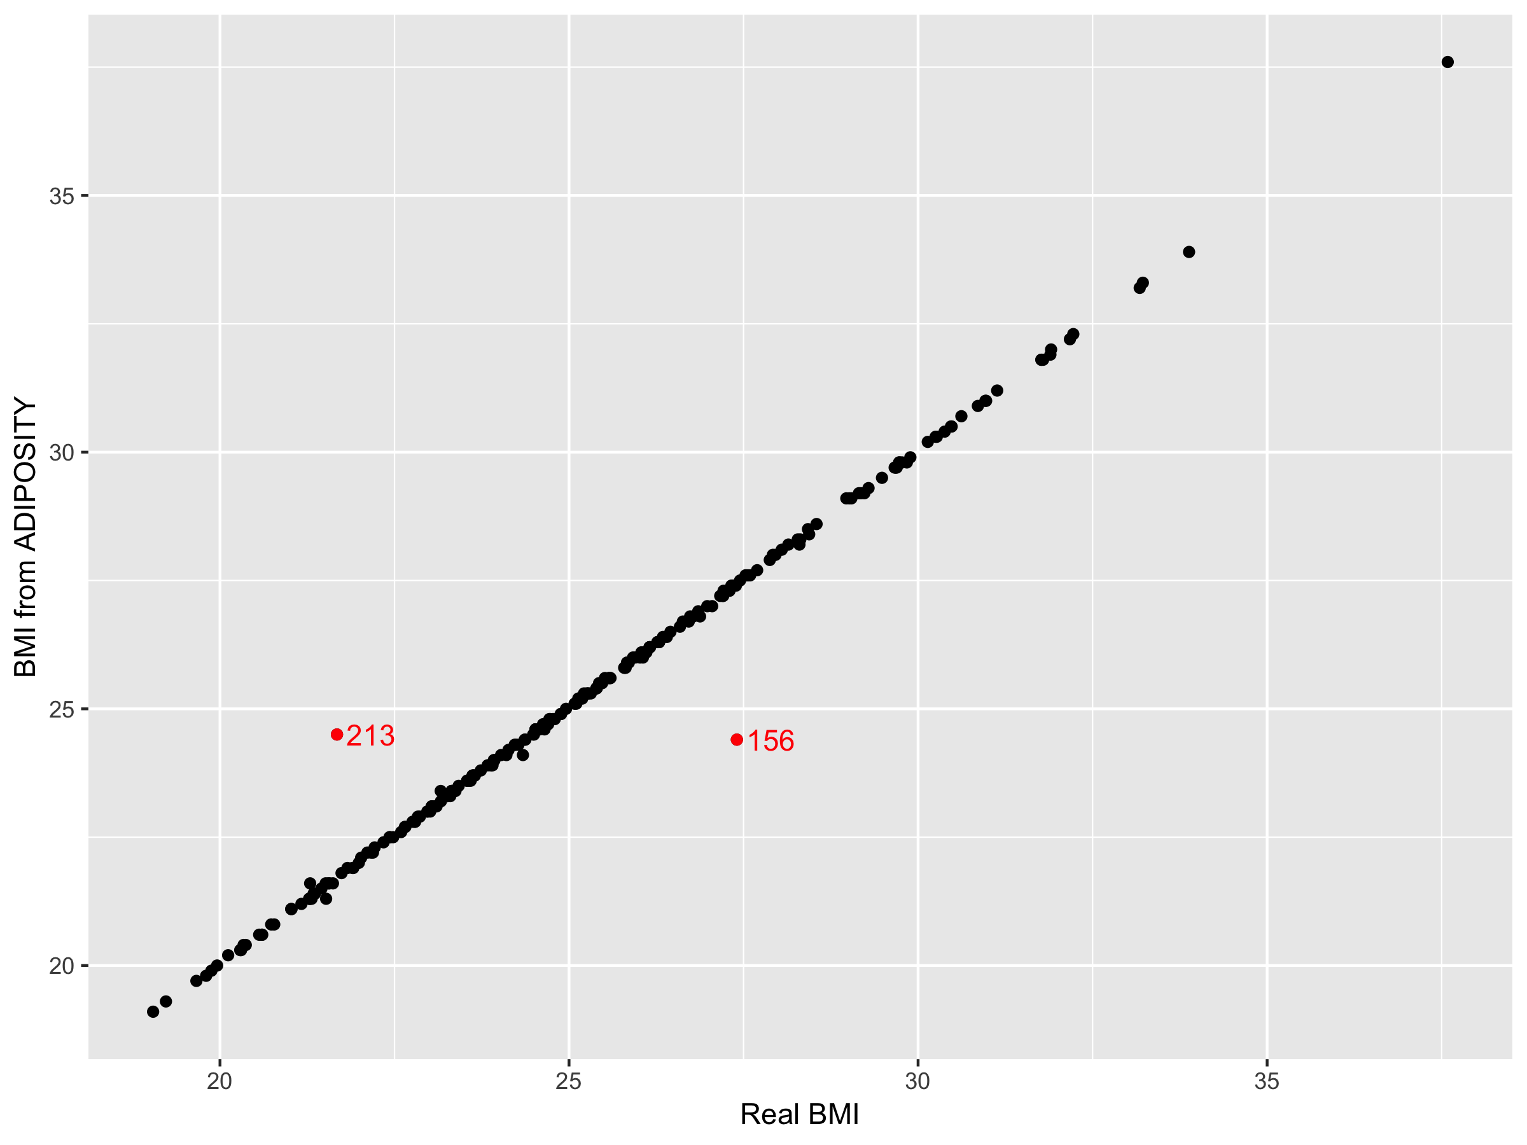
BMI Calculation
ADIPOSITY(BMI) = 703 * WEIGHT / HEIGHT ^ 2

Slide 10
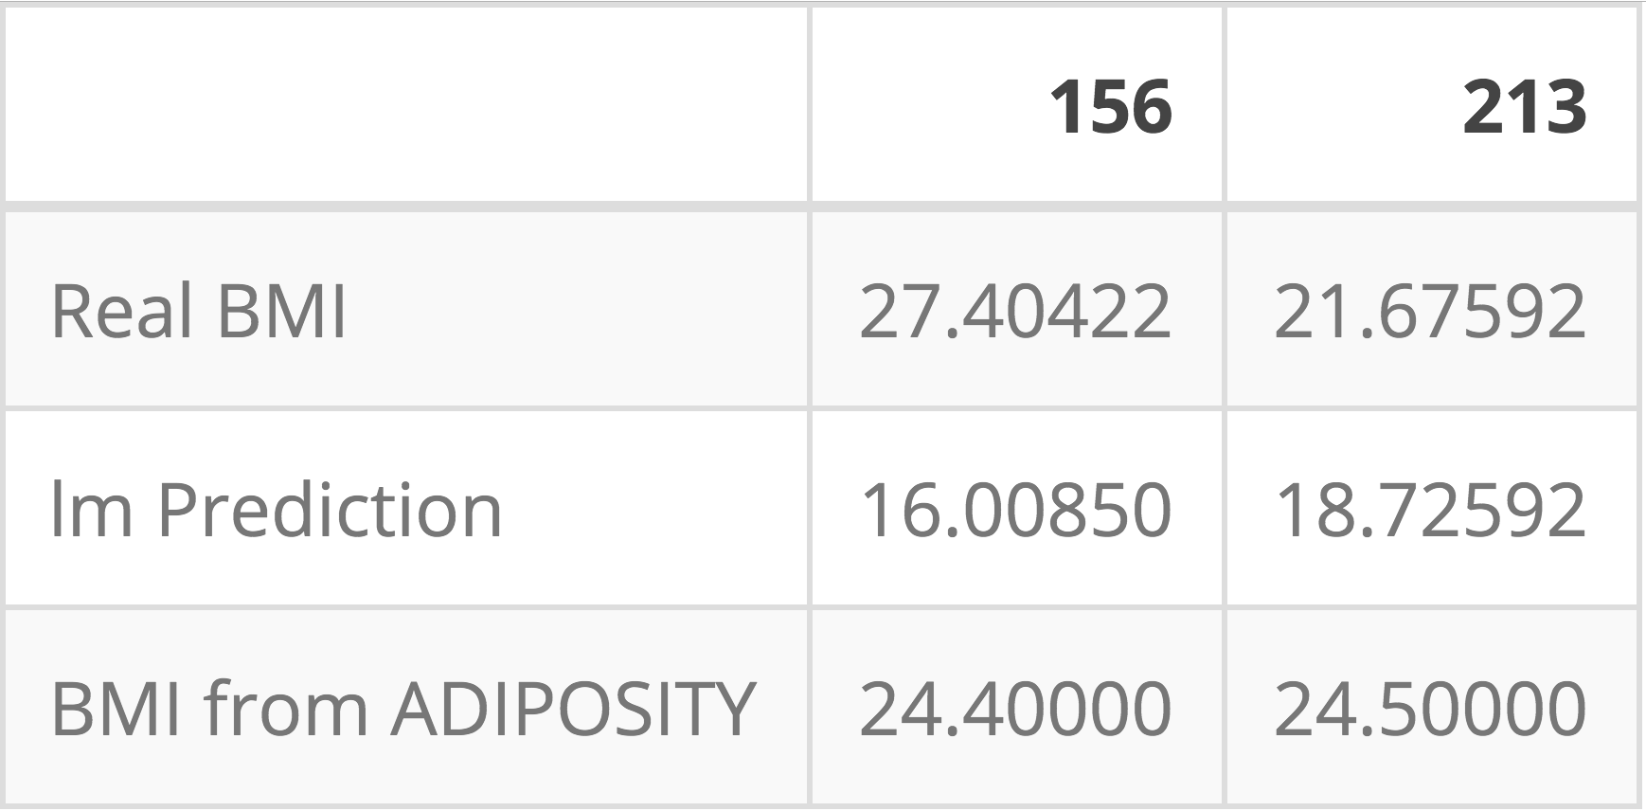
Linear Regression Prediction

Slide 11
Final Data
We also delete column DENSITY
It has 242 rows and 15 columns

Slide 12
Variable Selection
Stepwise variable selection
Direction: both side
AIC as the criterion

Slide 13
BODYFAT ~ AGE + HEIGHT + ABDOMEN + WRIST + ADIPOSITY + THIGH + WEIGHT
Not simple!
Collinearity problem!

Slide 14
VIF Plot

Slide 15
Models with Single Predictor
We consider 3 kinds of Model
1. Predictor: only one variable
Y ~ X
2. Predictor: product of two variables
Y ~ X1 * X2
3. Predictor: ratio of two variables
Y ~ X1 / X2

Slide 16
Models with Lowest MSE(under 3 forms)
Model Form | Best Model’s predictors | Lowest MSE of CV
Y ~ X | ABDOMEN | 19
Y ~ X1 * X2 | ADIPOSITY * ABDOMEN | 22
Y ~ X1 / X2 | ABDOMEN / HEIGHT | 17

Slide 17
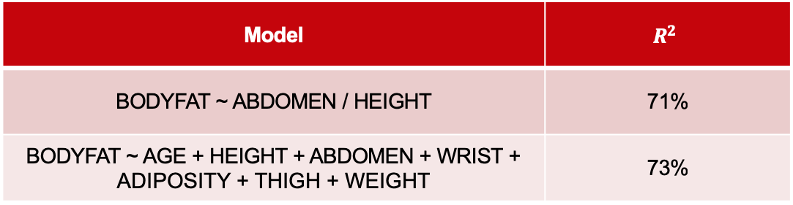
Comparison of Two Models
Model | $$R^{2}$$
BODYFAT ~ ABDOMEN / HEIGHT | 71%
BODYFAT ~ AGE + HEIGHT + ABDOMEN + WRIST + ADIPOSITY + THIGH + WEIGHT | 73%

Slide 18
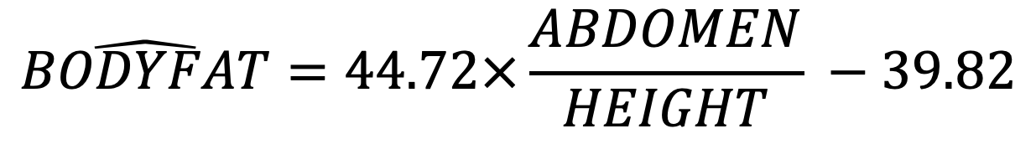
Final Model
$$\hat{BODYFAT}=44.72×\frac{ABDOMEN}{HEIGHT} −39.82$$
Rule of Thumb
Divide your abdomen circumference(cm) by your height(inches), then multiple 45 and then minus 40

Slide 19
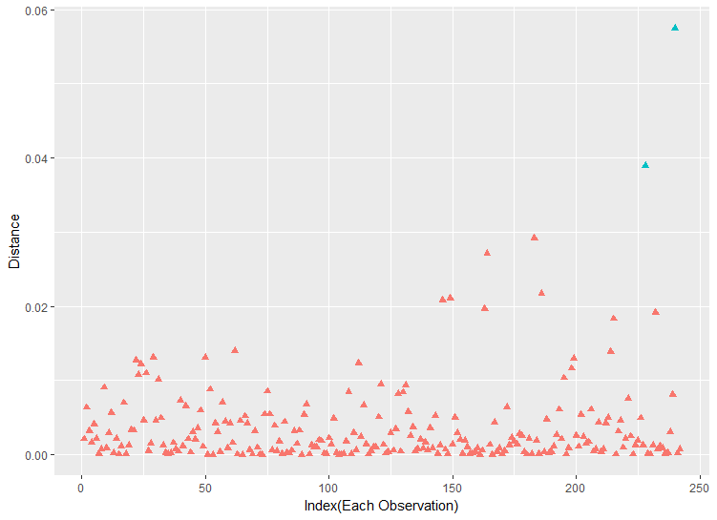
Influential values ( Cook’s distance)

Slide 20
Recheck these 2 point:
 | Point 228 | Point 240 | 1st Qu | mean | 3rd Qu
Height(inch) | 69.5 | 66.0 | 68.3 | 70.1 | 72.3
Abdomen(cm) | 113.8 | 111.5 | 84.8 | 92.4 | 99.2
Since these two most "strange" points have reasonable data, we consider all the points could be involved in our model.

Slide 21
Diagnostics
Linearity:
Scatter plot with the regression line
Constant variance:
Residual plot
Normally distributed errors:
Normal QQ plot

Slide 22
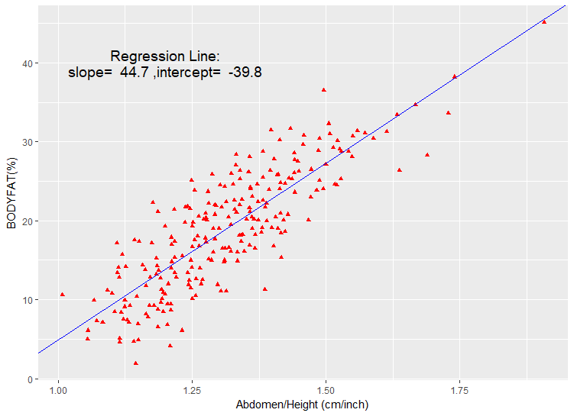
Scatter plot for BodyFat % vs Abdomen/Height

Slide 23
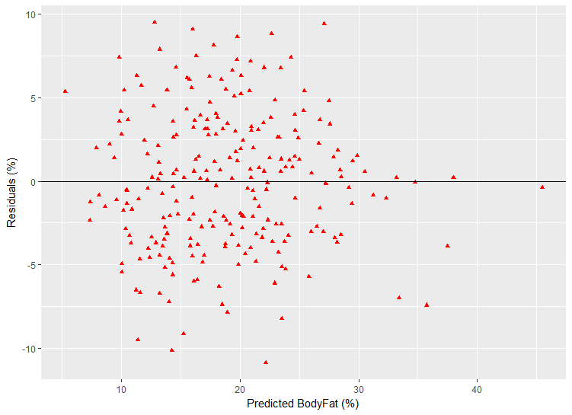
Residual plot

Slide 24
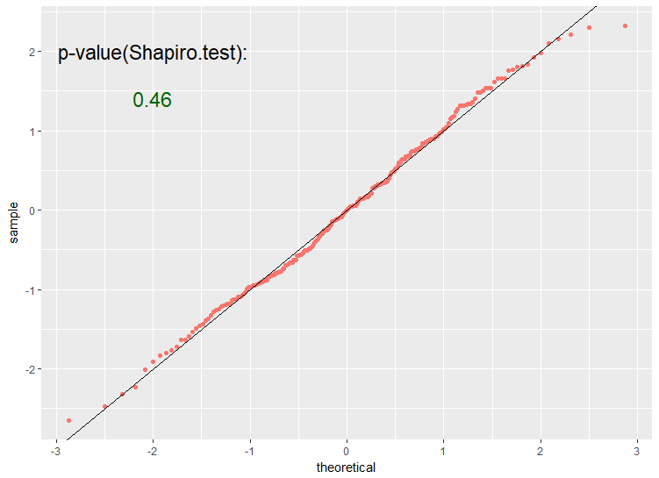
Normal QQ plot

Slide 25
Strength and Weakness of Model
Data cleaning:
Seems completed
Simplicity:
2 variables, 1 coefficient, 1 intercept
Robustness:
Remain robust to different body-sized men
Accuracy:
Could improve if adding more variables into model

Slide 26
Summary
There is almost surely a linear relationship between BodyFat % and Abdomen / Height, this is significant at the α=0.05 level (with p-value <2∗10^(-16) ). And, Abdomen / Height explains about 71% of all the variation in BodyFat %, so this model is considered simple and accurate.
According to this model, applied to people with a 70 inch height (the mean of data), a 1.57 cm increase in Abdomen may lead to a 1% increase in BodyFat %.

